Slide 1
Outline
Definition of congestion queue
Cascade effect of congestion queue
preliminary model for studying routing induced deadlock

Slide 2
Outline
Definition of congestion queue
Cascade effect of congestion queue
preliminary model for studying routing induced deadlock

Slide 3
Definition of congestion queue
flows
pause
…
switch egress queue
Definition of congestion queue: if PFC PAUSE frames are generated due to the packet queuing in a switch egress queue, we say this queue is a congestion queue.

Slide 4
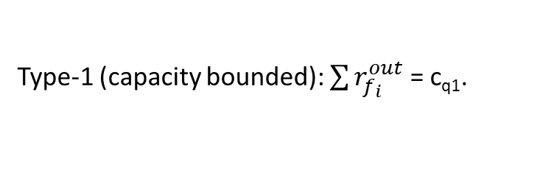
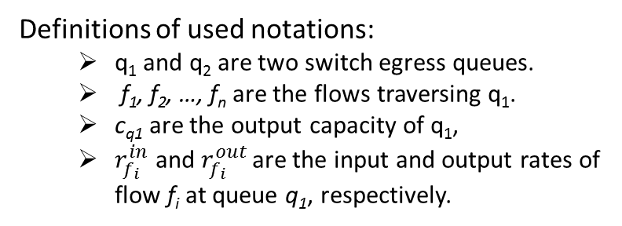
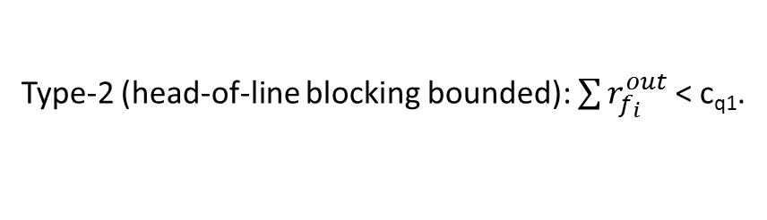
Classification of congestion queue
There are two types of congestion queues:
f₁
c_{q1}
f₁
pause
c(q₁)
f₂
…
f₂
…
…
f_{n}
q₁
f_{n}
q₁ (type-2)
q₂ (type-1)
Type-1 (capacity bounded): $\sum{r_{f_{i}}^{out}}$ = c_{q1}.
Type-2 (head-of-line blocking bounded): $\sum{r_{f_{i}}^{out}}$ < c_{q1}.
Definitions of used notations:
q₁ and q₂ are two switch egress queues.
f₁, f₂, …, f_{n} are the flows traversing q₁.
c_{q1} are the output capacity of q₁,
$r_{f_{i}}^{in}$ and $r_{f_{i}}^{out}$ are the input and output rates of flow f_{i} at queue q₁, respectively.

Slide 5

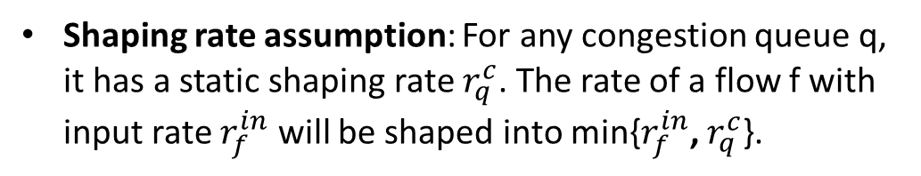


Assumption about congestion queue
r_{in} = $r_{f}^{in}$
r_{out} = $r_{q}^{c}$
flow f with injection rate $r_{f}^{in}$
q
Shaping rate assumption: For any congestion queue q, it has a static shaping rate $r_{q}^{c}$. The rate of a flow f with input rate $r_{f}^{in}$ will be shaped into min{$r_{f}^{in}$, $r_{q}^{c}$}.

Slide 6
Outline
Definition of congestion queue
Cascade effect of congestion queue
preliminary model for studying routing induced deadlock

Slide 7
Cascade effect of congestion queue
Step-0:
flow 2
r₂
r_{1,} r₂, r₃ > r_{c}
A
rx
tx
r^{c}
r^{c}
r₁
flow 1
B
C
tx
rx
rx
flow 3
tx
r₃
The tx queue of switch B is a congestion queue, and rates of flow 1 and flow 2 are shaped by it.

Slide 8
Cascade effect of congestion queue
Step-1:
flow 2
r₂
r_{1,} r₂, r₃ > r_{c}
A
rx
tx
r^{c}
r^{c}
r₁
flow 1
B
r^{c}
C
tx
rx
rx
flow 3
tx
r₃
r^{c}
Packets are queued in the tx queue of switch B. The tx queue of switch C becomes a new congestion queue, and rates of flow 2 and flow 3 are shaped by it.

Slide 9
Cascade effect of congestion queue
Step-2:
flow 2
r₂
r_{1,} r₂, r₃ > r_{c}
A
r^{c}
rx
tx
r^{c}
r^{c}
r^{c}
r₁
flow 1
B
r^{c}
C
tx
rx
rx
flow 3
tx
r₃
r^{c}
Packets are queued in the tx queue of switch C. The tx queue of switch A becomes a new congestion queue, and rates of flow 1 and flow 2 are shaped by it.

Slide 10
Cascade effect of congestion queue
Step-3:
flow 2
r₂
r_{1,} r₂, r₃ > r_{c}
A
r^{c}
rx
tx
r^{c}
r^{c}
r^{c}
r₁
flow 1
B
r^{c}
C
tx
rx
rx
flow 3
tx
r₃
r^{c}
Packets are queued in the tx queue of switch A. A deadlock occurs due to the cyclic buffer dependency.

Slide 11
Cascade effect of congestion queue
r₁ = r^{f}
r₂ = r^{c}_{q}
flow f
q₁
q₂
r₁ = r^{f}
r₂ = r^{c}_{q}
flow f
pause
q₁
q₂
Cascade effect of congestion queue: once a flow is shaped at one congestion queue, the upstream egress queue will become a new congestion queue due to PFC pause.

Slide 12
Outline
Definition of congestion queue
Cascade effect of congestion queue
preliminary model for studying routing induced deadlock

Slide 13
Fluid model
Elements of fluid model:
N = (V, E) | A lossless output-queued network, where V is the set of switches and E is the set of links .
F = {f₁, f₂, …, f_{n}} | The set of flows traversing N.
Q = {q₁,q₂,… ,q_{m}} | The set of egress queues of all the switches in V.
Q_{c}= {q₁,q₂,… ,q_{k}} | The set of congestion queues, Q_{c}⊆Q.
Three assumptions:
PFC threshold is a fixed value, and buffer of all egress queues are large enough to trigger PFC before packet drop.
The injection rates of all flows are fixed at the source.
congestion queue has static shaping rate.

Slide 14
Cascade computation of congestion queues
Given N, F, Q and a congestion queue q₀, we can get Q_{c} with a cascade computation as below:
Initialization: (1) Q_{c} = {q₀}; (2) ∀𝑓∈𝐹, set f’s output rate at all traversing egress queues as its injection rate.
Step-1: ∀𝑞∈Q_{c}, perform rate shaping for all flows traversing q, and mark all corresponding upstream egress queues as new congestion queues.
Step-2: compute static shaping rates for all new congestion queues, and add them into Q_{c ;}
∃𝑞∈Q_{c}, q has some flows to shape?
Yes
No
Output Q_{c};

Slide 15
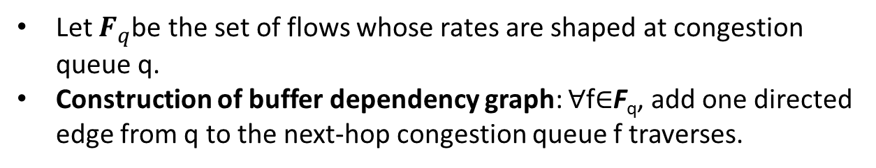
Buffer dependency graph of congestion queues
flow 2
{f1, f2}
A
rx
tx
{f1, f3}
flow 1
B
C
tx
rx
flow 3
rx
tx
{f2, f3}
Topology and flows
Buffer dependency graph of congestion queues
Let $F_{q}$be the set of flows whose rates are shaped at congestion queue q.
Construction of buffer dependency graph: ∀f∈F_{q}, add one directed edge from q to the next-hop congestion queue f traverses.

Slide 16
Sufficient condition for deadlock creation
Sufficient condition for deadlock creation: there is a cycle in the buffer dependency graph of congestion queues.
Proof: Suppose there is a cycle in the buffer dependency graph of congestion queues. For any congestion queue in the cycle, it will pause its last-hop queue once the packets received from last-hop queue exceed PFC threshold. When PFC threshold is triggered at all queues in the cycle, there will be a loop of PFC pause frames and a deadlock is created.

Slide 17
Issues currently not considered in the model
Shaping rate of a congestion queue is dynamic.
How the buffer of a congestion queue is shared by all the input flows can be very complicated and dynamic.
Injection rate of a flow can be dynamic.
PFC threshold is computed according to a dynamic algorithm.

